Slide 1
UNIT-1
Introduction to MS Excel
Part-3

Slide 2
Reference Styles
Every Excel spreadsheet contains rows and columns.
Most of the time, columns are identified by letters (A, B, C), and rows are identified by numbers (1, 2, 3). In Excel, this is known as the A1 reference style.
However, some prefer to use a different method where columns are also identified by numbers. This is known as the R1C1 reference style.

Slide 3
A1-Style References
The A1-style is the most common form of Excel referencing, and is the default style.
This style of referencing is made up of a letter and a number, which represent the column reference and the row number, respectively.
Cells A1-D4 are labelled in the spreadsheet below:

Slide 4
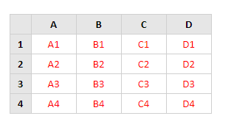

Slide 5
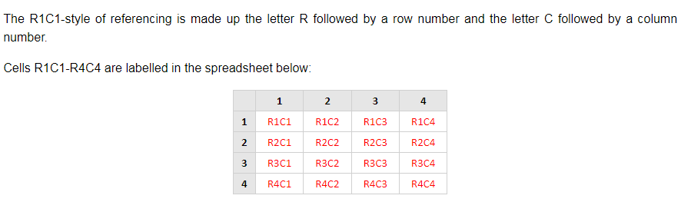
R1C1-Style References

Slide 6
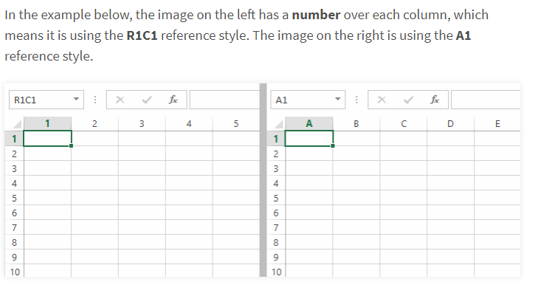

Slide 7
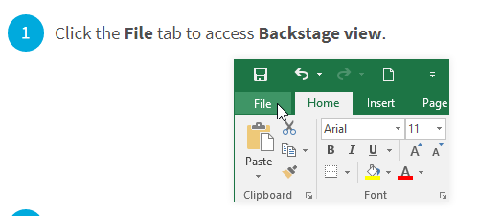
To turn off/on the R1C1 reference style:

Slide 8
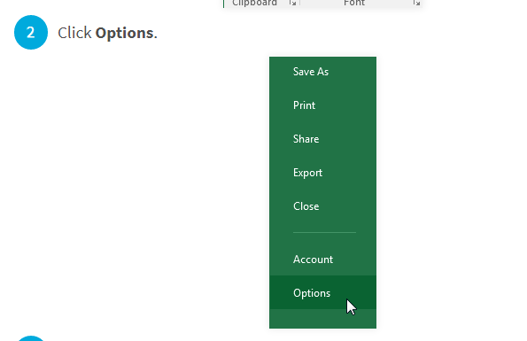

Slide 9
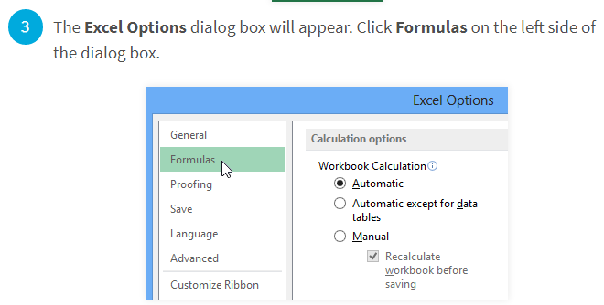

Slide 10
Uncheck the box next to R1C1 reference style, then click OK. Excel will now use the A1 reference style.

Slide 11
Formatting
There are different types of formatting in excel:
Font
Alignment
Number

Slide 12
Font
Bold
Italic
Underline
Border
Background Color
Font Color
Font
Font Size

Slide 13
Alignment
Merge and Center
Vertical Alignments
Horizontal Alignments
Rotate Text
Increase Indent/Decrease Indent
Wrap text

Slide 14
Number
Number formatting
Date
Currency

Slide 15
Custom Number Formatting
Below are some characters that we can use in custom number formatting:-
0 – Display insignificant zeros
#- Display significant zeros
? – Display aligned decimals
. – Decimal point
, - Thousands separator
* - Repeat
_ - Add Space
Notes:
00.000
##.###
0.0?
0,”k”
0,,”M”
0.0_);[Red](0.00)
*&00.###

Slide 16
Conditional Formatting
Highlight Cell rules
Top/Bottom rules
Data Bars
Color Scales
Icon sets

Slide 17
Format as Table
Table with header
Table without header
Notes:
Click on data then select filter to remove that
Connecting sheets in excel
Data tab
Existing connections

Slide 18
Auto sum
Auto fill
Flash fill
Cell referencing styles (3)
Speak cells
Notes:
Cells location
Text , number , logical value, error(1/0)
Speak cell
File options quick access then all commands then add all speak cells

